Slide 1

Campaign data report

Slide 2
Goal and proposals
We plan to adjust our ad strategy and budget to maximize conversions. We propose:
Running more ads during peak conversion periods to increase traffic
Running fewer ads when session volume is high, but conversions are low

Slide 3
Key performance indicators (KPIs)
Metrics we examined:
Daily sessions (site visits)
Conversions (account creations)
Conversion rate

Slide 4
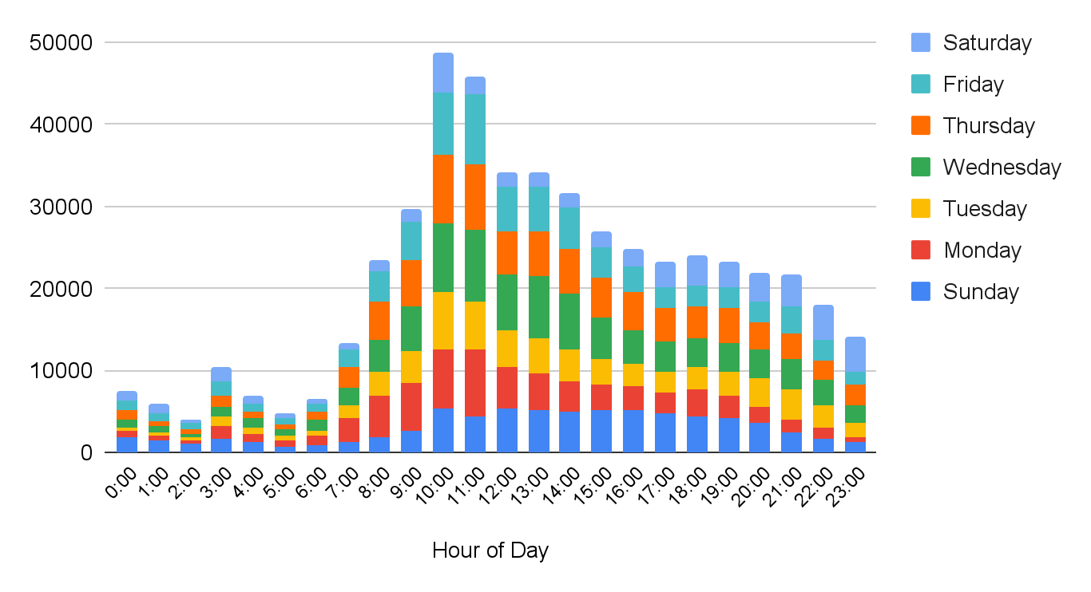
Total sessions by hour of day
Notes:
Summary: This chart shows the total number of sessions, broken down by times of day and days of the week. There is a general pattern to how this metric rises and falls over a 24-hour period: Sessions are at their lowest overnight, when many people are asleep. They climb sharply from 6:00 onward, until peaking around the 10:00 and 11:00 blocks. They then fall sharply around noon and level off before decreasing more slowly throughout the rest of the day. Overall session volume is highest from Wednesday to Friday, and lowest on Saturday. If we were considering session volume alone, weekdays between 10:00 and noon might seem like a the best time to run extra ads. But our conversion data tells a different story.

Slide 5
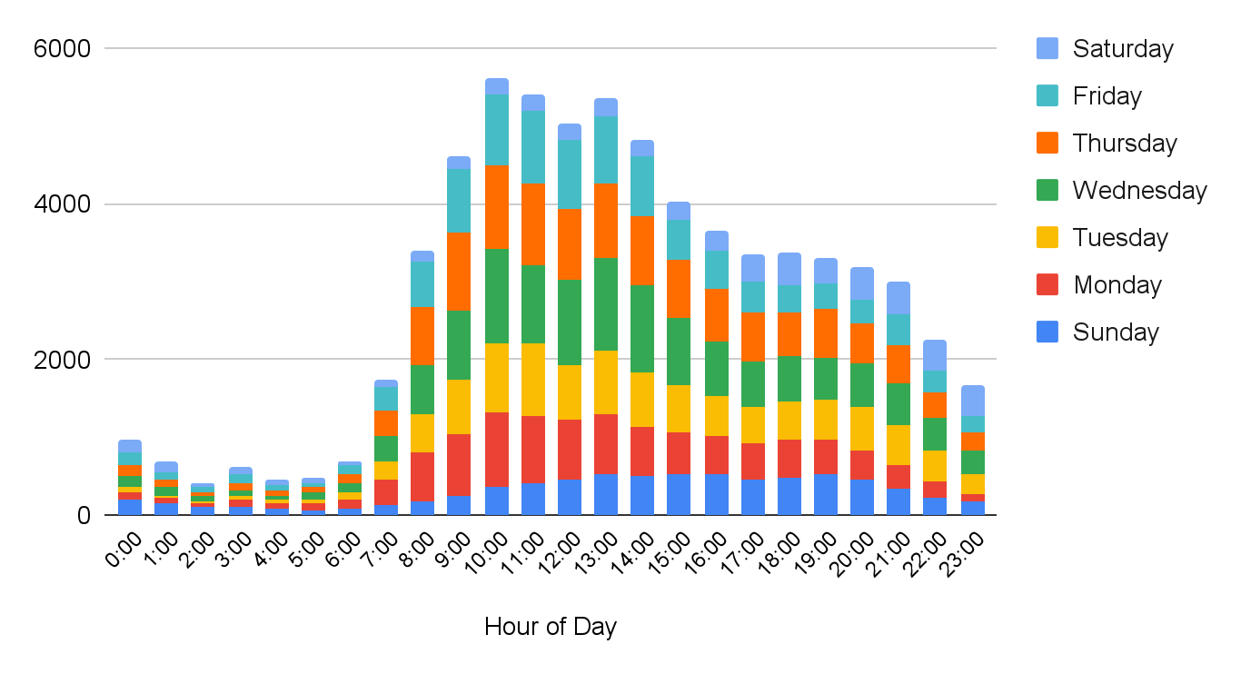
Total conversions by hour of day
Notes:
Summary: The peak hour range when we gain the most conversions is on 9:00-14:00 we should make sure we run ads at this time of the day. The weakest days performance is during Sunday and Saturday even at peak hours there is no significant spike in total conversions. We should focus on Tuesday, Wednesday and Thursday as they generate the most conversions compare to other days.

Slide 6
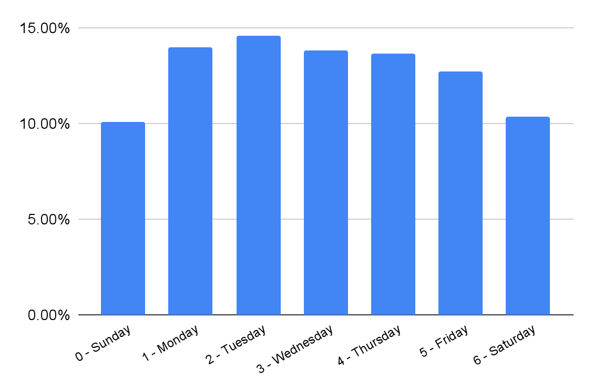
Average conversion rates by day of week
Average weekly CVR
12.75%
Notes:
Summary: Friday, Saturday, and Sunday are below the average conversion rate. We should switch our focus on Monday- Thursday as they will yield the most conversions since they are above the average weekly CVR. This further solidifies our finding on the previous slide that the weekends don't perform well in gaining conversions.

Slide 7
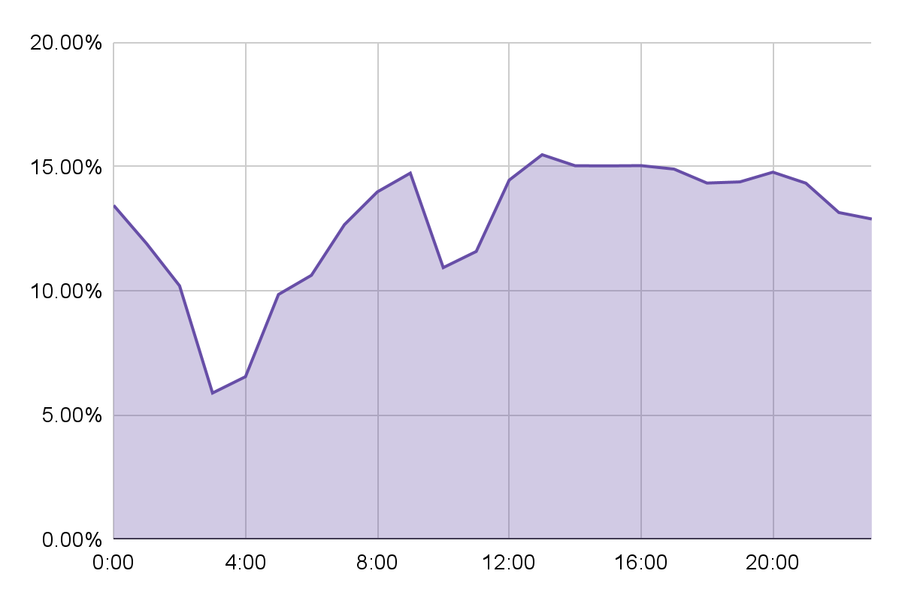
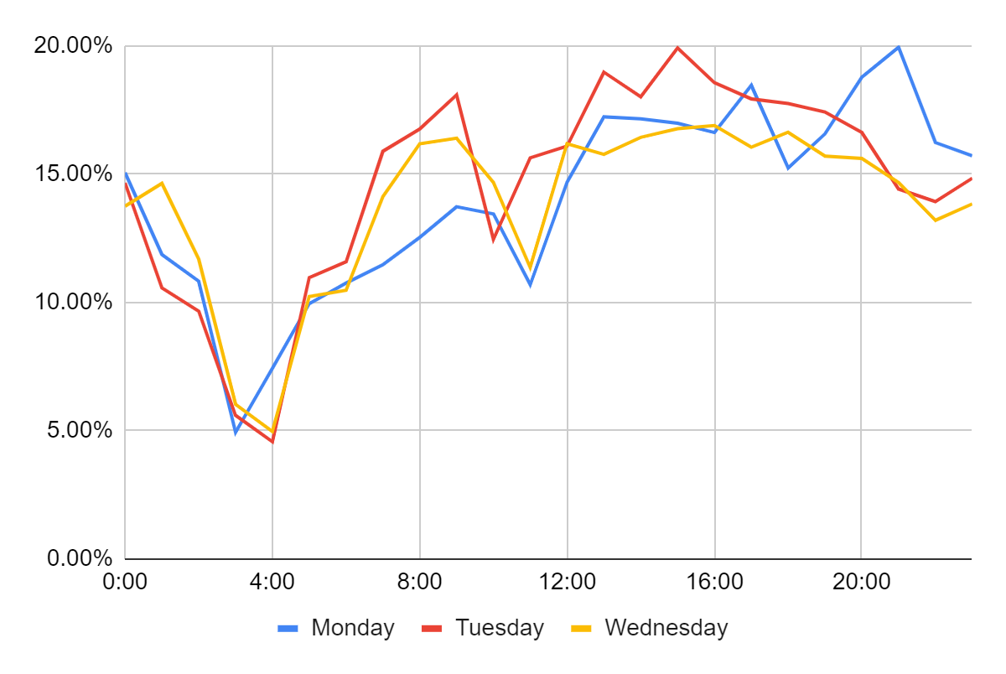
Weekly average conversion rates by hour of day
Monday-Wednesday conversion rates by hour of day
Notes:
Summary: We can see that there is a dead time from 2:00-4:00 with CVR dipping to around 5%. We can see that from 8:00-20:00 the CVR tends to be around 15% which is the peak CVR. This is echoed when we break down the CVR in just our best performing days.

Slide 8
Conclusions and next steps
We should run our ads from 8:00-20:00 as that is where we peak in conversion rates.
We should not focus anymore in weekends and instead focus on Monday-Thursday as this will be the most effective days to get conversions.
This aligns with the goal of the company as more conversion means that new people are signing up to create an account.

